Slide 1
Final Mini Project Demonstration
UE19CS306D
Project Title : Speech Calculator
Project Guide : Shylaja S. S.
Project Team : Mohith R, Chinmay Kulkarni, Sanjiv Sridhar

Slide 2
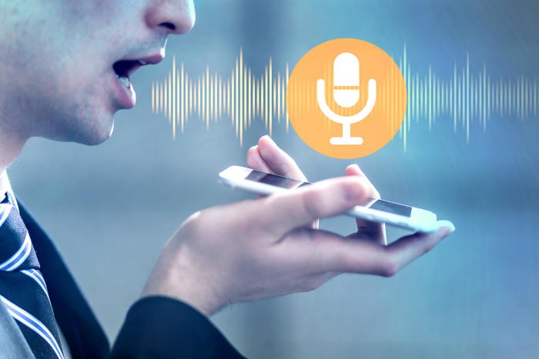
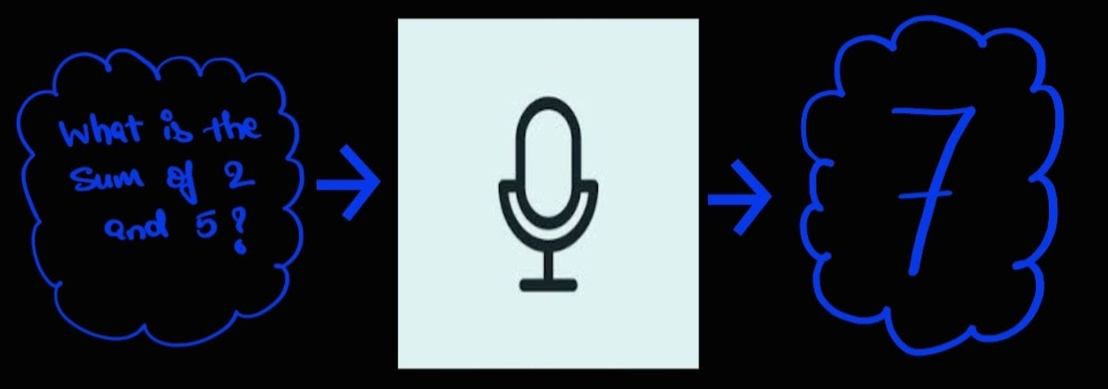
Project Abstract and Scope
An app to help people solve simple to complex mathematical problems by just the use of their voice.
Takes in a spoken mathematical query as input
Gives out the result of that query.
Using this project we hope to help the people who need quick answers to their mathematical queries like cashiers and grocery shop keepers.
We also target an audience which is differently abled and help them with this speech calculator.

Slide 3
Literature Survey
Title | Authors | Proposed Solution Summary
Automatic Speech Recognition Technique For Voice Command IEEE 2014 International Conference on Science Engineering and Management Research (ICSEMR) | Anshul Gupta, Nileshkumar Patel, Shabana Khan Jaypee University of Engineering & Technology, Guna M.P India. | The proposed solution is to take a single audio as an input and then eliminate the presence of noise, then match the patterns to recognize the input audio. The error tolerance mechanism is implemented so that it can be robust against human errors, environment noise.
Mathifier – Speech Recognition of Math Equations IEEE 2011 18th IEEE International Conference on Electronics, Circuits and Systems - (ICECS 2011) | Salim N. Batlouni, Hala S. Karaki, Fadi A. Zaraket, Fadi N. Karameh American University of Beirut | Mathifier constricts the speech recognition to math equations; it takes as input math formulas presented in the form of user speech and produces the equations in digital mathematical form. The smaller dictionary and the specific grammar structure of the math equations help restrict the problem of the recognition process.

Slide 4
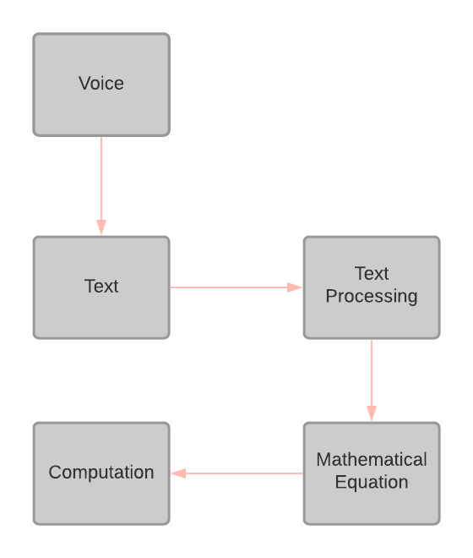
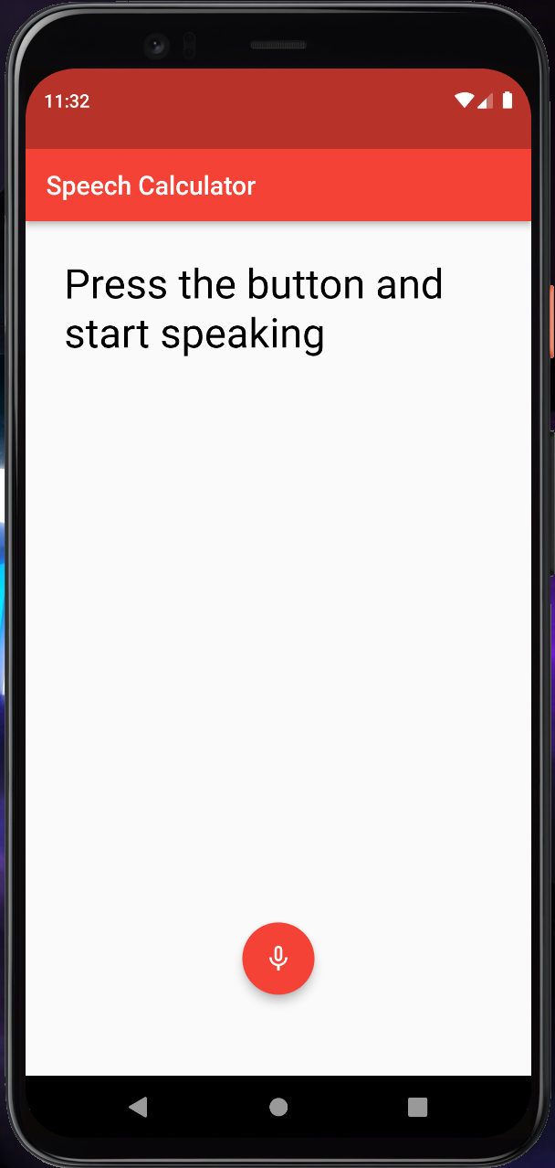
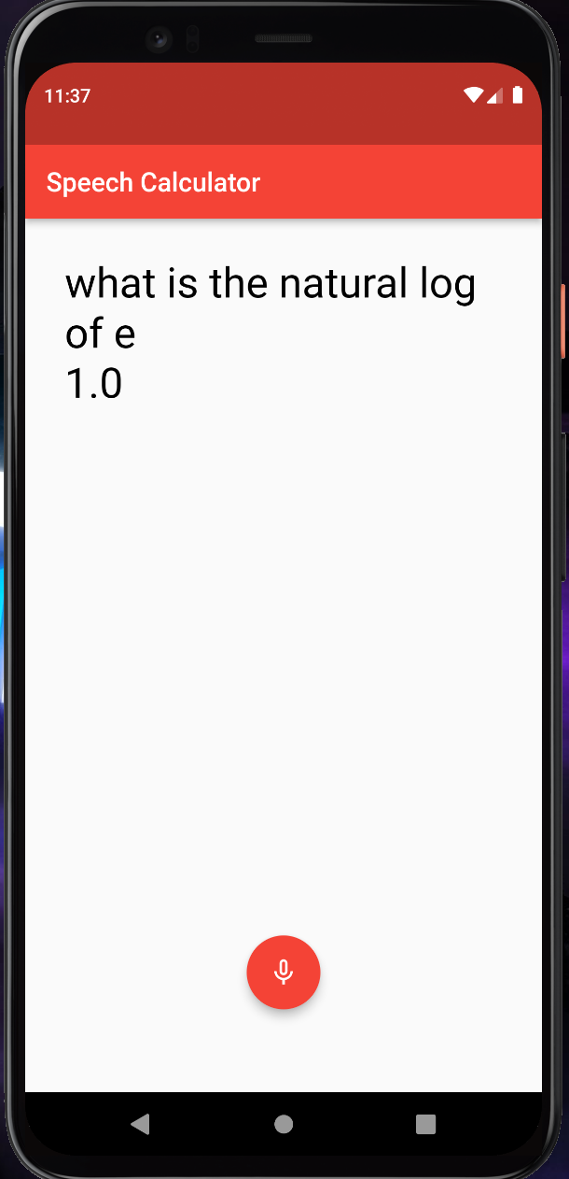
Design Description/UI Design

Slide 5
Technologies Used
The technologies/platforms/languages:
Python 3.x
Flutter
Dart
Android Studio
pyaudio with Google recognizer
Flutter Speech to Text module
Flask
Notes:
‹#›

Slide 6
Implementation
Steps Involved:
Taking in the voice from the user with Flutter UI
Converting Voice to Text
Converting the query into mathematical equation.
Converting the infix mathematical equation into postfix
Evaluating postfix expression
Integration of Python and Flutter
Notes:
‹#›

Slide 7
Implementation
Algorithm to convert the query into mathematical equation:
Create a Bag Of Words(operators)
For eg:
add_KW = {"sum", "add", "summation", "addition", "plus", "+"}
Initialise:
operand_list to empty_list
expr _list to empty_list
Iterate through the query:
If operand is numerical:
Add to operand_list
else if operand but expressed in english word for eg: million
Generate a new operand string with the previous operands and current operand
for eg: 10 million 27 thousand.
Set operand_list to contain only the new operand string
else:
Convert all the elements of operand_list to single operand string
Add the obtained operand from prev step to expr _list
Set operand_list to empty_list
Add the operator to expr _list based on which bag of words the word belongs to
Notes:
‹#›

Slide 8

Project Demo
Notes:
‹#›

Slide 9
Results
30 queries with 2 operands equations, the app was able to give correct predictions for all 30 queries.
50 queries with multiple operands and operators.In this case, the app needs to take care of the precedence and associativity since the query is long, the speech to text phase itself may fail sometimes, the app was able to predict correctly 46/50 times.
20 queries with queries format kept the same as the previous point but this time the app was tested with some external noise and by varying the mic distance from the user, the app was able to solve 14 out of 20 times correctly.
Notes:
‹#›

Slide 10
Conclusion and Future Work
The current logic cannot handle, the implicit precedence for instance if the user query is “add 2 and 3 multiply the result with 5”, and some more cases which requires the understanding of English language itself is not handled in the current version of the appI
Introducing NLP could improve the accuracy of the model.
Dataset Creation for NLP model(In progress)
Adding more features to the app.
Notes:
‹#›

Slide 11
References
List of research papers referred :
[1] S. Furui, “Recent advances in robust speech recognition,” in Proc. ESCA-NATO Tutorial and Research Workshop on Robust Speech Recognition for Unknown Communication Channels, Pont-a-Mousson, France, Apr. 1997, pp.11–20.
[2] Gupta, Anshul; Patel, Nileshkumar; Khan, Shabana (2014). [IEEE 2014 International Conference on Science Engineering and Management Research (ICSEMR) - Chennai, India (2014.11.27-2014.11.29)] 2014 International Conference on Science Engineering and Management Research (ICSEMR) - Automatic speech recognition technique for voice command.
[3] Y.-F. Gong, “Speech recognition in noisy environments: A survey,” Speech Commun., vol. 16, pp. 261–291, 1995.
[4] B.-H. Juang, “Speech recognition in adverse environments,” Comput. Speech Lang., vol. 5, pp. 275–294, 1991.
[5] S. Young and N. Ressell, “Token passing: a simple conceptual model for connected speech recognition systems,” Cambridge University Engineering Department, 1989.
[6] Batlouni, Salim N.; Karaki, Hala S.; Zaraket, Fadi A.; Karameh, Fadi N. (2011). [IEEE 2011 18th IEEE International Conference on Electronics, Circuits and Systems - (ICECS 2011) - Beirut, Lebanon (2011.12.11-2011.12.14)] 2011 18th IEEE International Conference on Electronics, Circuits, and Systems - Mathifier - Speech recognition of math equations.
Notes:
‹#›

Slide 12
Thank You

